Slide 1
Analysis Concepts and Principles
Chapter 6

Slide 2
Requirement Engineering
Requirements engineering provides the appropriate mechanism for understanding what the customer wants, analyzing need, assessing feasibility, negotiating a reasonable solution.
The requirements engineering process can be described in five distinct steps
• requirements elicitation:
• requirements analysis and negotiation:
• requirements specification:
• system modeling:
• requirements validation:
• requirements management:

Slide 3
Software Requirement Engineering
Software requirements engineering is a process of discovery, refinement, modeling, and specification.
The system requirements and role allocated to software—initially established by the system engineer—are refined in detail.
Models of the required data, information and control flow, and operational behavior are created
Alternative solutions are analyzed and a complete analysis model is created.

Slide 4
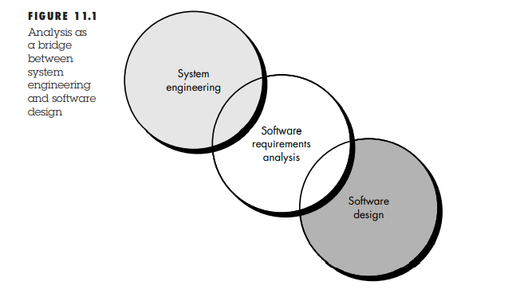
Requirement Analysis

Slide 5
Requirement Analysis
Requirements analysis is a software engineering task that bridges the gap between system level requirements engineering and software design.
Requirements analysis allows the software engineer to refine the software allocation and build models of the data, functional, and behavioral domains that will be treated by software.
Requirements analysis provides the software designer with a representation of information, function, and behavior that can be translated to data, architectural, interface, and component-level designs.

Slide 6
Requirement Analysis
Requirements specification provides the developer and the customer with the means to assess quality once software is built.
Software requirements analysis may be divided into five areas of effort:
(1) problem recognition:
(2) evaluation and synthesis:
(3) modeling:
(4) specification:
(5) review:
Initially, the analyst studies the System Specification (if one exists) and the Software Project Plan

Slide 7
Requirement Analysis
It is important to understand software in a system context and to review the software scope that was used to generate planning estimates.
Next, communication for analysis must be established so that problem recognition is ensured.
The goal is recognition of the basic problem elements as perceived by the customer/users

Slide 8
Requirement Analysis
Problem evaluation and solution synthesis is the next major area of effort for analysis.
The analyst must define all externally observable data objects, evaluate the flow and content of information, define and elaborate all software functions, understand software behavior in the context of events that affect the system.
Each of these tasks serves to describe the problem so that an overall approach or solution may be synthesized

Slide 9
Requirement Analysis
Upon evaluating current problems and desired information (input and output), the analyst begins to synthesize one or more solutions
Throughout evaluation and solution synthesis, the analyst's primary focus is on "what," not "how."
What data does the system produce and consume, what functions must the system perform, what behaviors does the system exhibit, what interfaces are defined and what constraints apply?

Slide 10
Requirement Analysis
During the evaluation and solution synthesis activity, the analyst creates models of the system in an effort to better understand data and control flow, functional processing, operational behavior, and information content.
The model serves as a foundation for software design and as the basis for the creation of specifications for the software

Slide 11
Requirement Elicitation
Before requirements can be analyzed, modeled, or specified they must be gathered through an elicitation process
Requirement elicitation is the practice of obtaining the requirements of a system from users, customers and other stake holders
Requirements elicitation Methods:
Interviews
Brainstorming Sessions
Facilitated Application Specification Technique (FAST)
Quality Function Deployment (QFD)
Use Case Approach

Slide 12
Interviews
Objective of conducting an interview is to understand the customer’s expectations from the software.
It is impossible to interview every stakeholder hence representatives from groups are selected based on their expertise and credibility.
Interviews maybe be open-ended or structured.
In open-ended interviews there is no pre-set agenda. Context free questions may be asked to understand the problem.
In structured interview, agenda of fairly open questions is prepared. Sometimes a proper questionnaire is designed for the interview.

Slide 13
Brainstorming Sessions:
It is a group technique
It is intended to generate lots of new ideas hence providing a platform to share views
A highly trained facilitator is required to handle group bias and group conflicts.
Every idea is documented so that everyone can see it.
Finally, a document is prepared which consists of the list of requirements and their priority if possible.

Slide 14
Facilitated Application Specification Technique
It’s objective is to bridge the expectation gap between what the developers think they are supposed to build and what customers think they are going to get.
Many different approaches to FAST have been proposed.
Each of them makes use of a slightly different scenario, but all apply some variation on the following basic guidelines:
A meeting is conducted at a neutral site and attended by both software engineers and customers.
Rules for preparation and participation are established.
An agenda is suggested that is formal enough to cover all important points but informal enough to encourage the free flow of ideas.

Slide 15
Facilitated Application Specification Technique
A "facilitator" (can be a customer, a developer, or an outsider) controls the meeting.
A "definition mechanism" (can be work sheets, flip charts, or wall stickers or an electronic bulletin board, chat room or virtual forum) is used.
The goal is to identify the problem, propose elements of the solution, negotiate different approaches, and specify a preliminary set of solution requirements in an atmosphere that is conducive to the accomplishment of the goal.

Slide 16
Quality Function Deployment
Quality function deployment (QFD) is a quality management technique that translates the needs of the customer into technical requirements for software.
QFD “concentrates on maximizing customer satisfaction from the software engineering process
QFD identifies three types of requirements
Normal Requirement
Expected Requirement
Exciting Requirement

Slide 17
Quality Function Deployment
Normal requirements – In this the objective and goals of the proposed software are discussed with the customer.
Example – normal requirements for a result management system may be entry of marks, calculation of results, etc
Expected requirements – These requirements are so obvious that the customer need not explicitly state them.
Example – protection from unauthorized access.
Exciting requirements – It includes features that are beyond customer’s expectations and prove to be very satisfying when present.
Example – when unauthorized access is detected, it should backup and shutdown all processes.

Slide 18
Use-Cases
Use-Cases
Provide a description of how the system will be used
The use-cases describes the manner in which an actor interacts with the system.
The components of the use case design includes three major things – Actor, Use cases, use case diagram.
Actor – It is the external agent that lies outside the system but interacts with it in some way.
An actor maybe a person, machine etc. It is represented as a stick figure

Slide 19
Use cases
They describe the sequence of interactions between actors and the system.
They capture who(actors) do what(interaction) with the system.
A complete set of use cases specifies all possible ways to use the system.

Slide 20
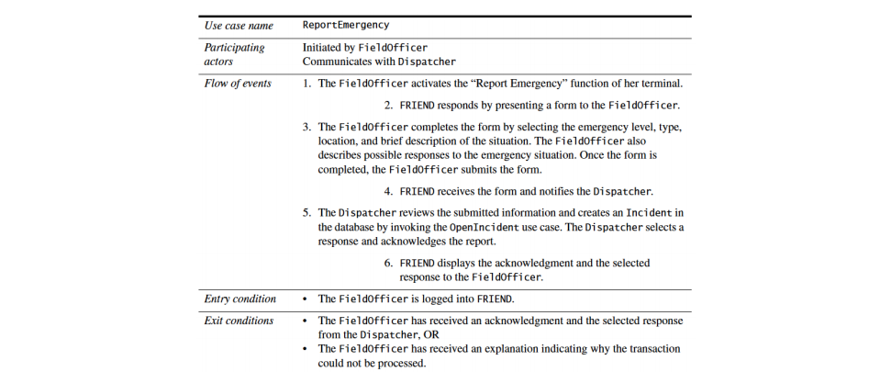
Use-Case (Example)

Slide 21
Use-Case Diagram
A use case diagram graphically represents what happens when an actor interacts with a system.
It captures the functional aspect of the system.
A stick figure is used to represent an actor.
An oval is used to represent a use case.
A line is used to represent a relationship between an actor and a use case.

Slide 22
Use Case Diagram
UML use case diagrams are ideal for:
Representing the goals of system-user interactions
Defining and organizing functional requirements in a system
Specifying the context and requirements of a system
Modeling the basic flow of events in a use case

Slide 23







Notation used in Use case Diagram

Slide 24
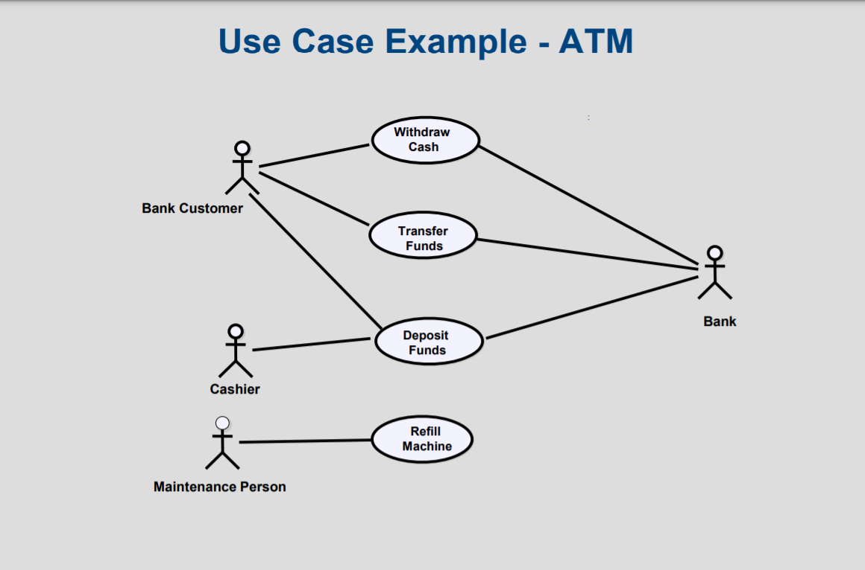
Use Case Diagram

Slide 25
Software Requirement Specification
software requirements specification (SRS) is a document that describes what the software will do and how it will be expected to perform.
It also describes the functionality the product needs to fulfill all stakeholders (business, users) needs.

Slide 26
Why Use an SRS Document?
A software requirements specification is the basis for your entire project.
It lays the framework that every team involved in development will follow.
It’s used to provide critical information to multiple teams — development, quality assurance, operations, and maintenance.
Using the SRS helps to ensure requirements are fulfilled
Writing an SRS can also minimize overall development time and costs

Slide 27
Outline for SRS
1. Introduction
1.1 Purpose
1.2 Intended Audience
1.3 Intended Use
1.4 Scope
1.5 Definitions and Acronyms
2. Overall Description
2.1 User Needs
2.2 Assumptions and Dependencies
3. System Features and Requirements
3.1 Functional Requirements
3.2 External Interface Requirements
3.3 System Features
3.4 Nonfunctional Requirements

Slide 28
Types of Requirements
Functional requirements:
Functional requirements are essential to building your product.
input/output
processing.
error handling.
Non-functional requirements:
Performance
Safety
Security
Quality

